Slide 1
More Complex SQL Retrieval Queries
Other SQL Constructs: WITH and CASE
The WITH clause allows a user to define a table that will only be used in a particular query.
Its similar to creating a view used for next query & then dropped
This construct is not available in all SQL based DBMSs

Slide 2
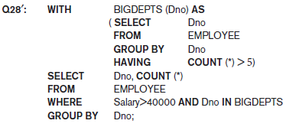
More Complex SQL Retrieval Queries
Other SQL Constructs: WITH and CASE
In Q28′, we defined in the WITH clause a temporary table BIG_DEPTS whose result holds the Dno’s of departments with more than five employees, then used this table in the subsequent query.
Once this query is executed, the temporary table BIGDEPTS is discarded.

Slide 3
More Complex SQL Retrieval Queries
Other SQL Constructs: WITH
It is considered “temporary” because the result is not permanently stored anywhere in the database schema.
advantage:
simplify long and complex hierarchical queries
by breaking them down into smaller, more readable chunks.

Slide 4
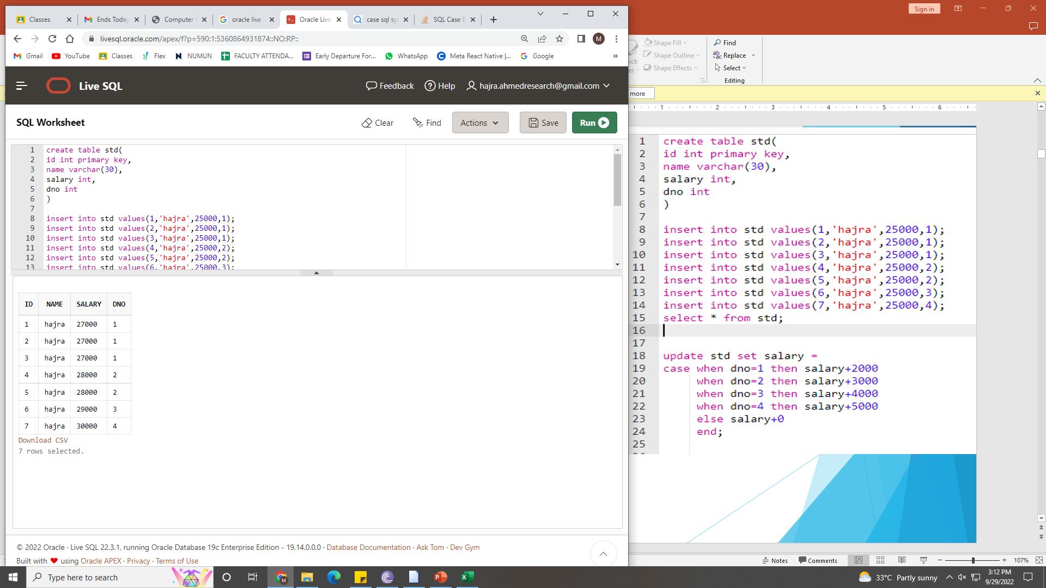
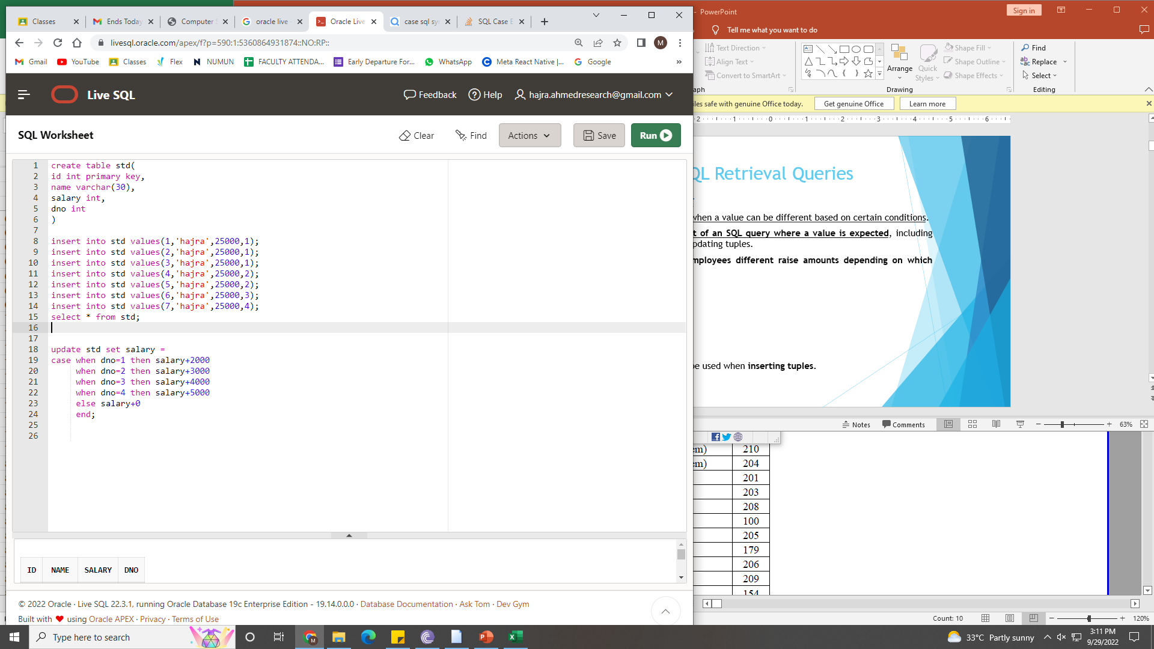
More Complex SQL Retrieval Queries
Other SQL Constructs: CASE
CASE construct can be used when a value can be different based on certain conditions.
This can be used in any part of an SQL query where a value is expected, including when querying, inserting or updating tuples.
Suppose we have to give employees different raise amounts depending on which department they work for.
The CASE construct can also be used when inserting tuples.

Slide 5
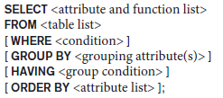
More Complex SQL Retrieval Queries– repeated overview
Discussion and Summary of SQL Queries A retrieval query in SQL can consist of up to six clauses, but only the first two— SELECT and FROM—are mandatory.
The query can span several lines and is ended by a semicolon.
Query terms are separated by spaces, and parentheses can be used to group relevant parts of a query in the standard way.
The clauses are specified in the following order, with the clauses between square brackets [ … ] being optional.

Slide 6
More Complex SQL Retrieval Queries – repeated overview
Discussion and Summary of SQL Queries
The SELECT clause lists the attributes or functions to be retrieved.
The FROM clause specifies all relations (tables) needed in the query, including joined relations, but not those in nested queries.
The WHERE clause specifies the conditions for selecting the tuples from these relations, including join conditions if needed.
GROUP BY specifies grouping attributes, whereas HAVING specifies a condition on the groups being selected rather than on the individual tuples.
The built-in aggregate functions COUNT, SUM, MIN, MAX, and AVG are used in conjunction with grouping, but they can also be applied to all the selected tuples in a query without a GROUP BY clause.
Finally, ORDER BY specifies an order for displaying the result of a query.

Slide 7
More Complex SQL Retrieval Queries
Discussion and Summary of SQL Queries
A query is evaluated conceptually by first applying the FROM clause (to identify all tables involved in the query or to materialize any joined tables), followed by the WHERE clause to select and join tuples, and then by GROUP BY and HAVING.
Conceptually, ORDER BY is applied at the end to sort the query result.
If none of the last three clauses (GROUP BY, HAVING, and ORDER BY) are specified, we can think conceptually of a query as being executed as follows:
For each combination of tuples—one from each of the relations specified in the FROM clause—evaluate the WHERE clause; if it evaluates to TRUE, place the values of the attributes specified in the SELECT clause from this tuple combination in the result of the query.

Slide 8
Schema Change Statements in SQL
Schema changes are required when:
a relation/constraint is altered or dropped from the schema
For that schema evolution commands are used
For example, ALTER and DROP
These don’t need recompilation of database schema as the changes are done in existing DBMS.
Just make sure that the DBMS remains in the consistent state even after the changes are done.

Slide 9
Schema Change Statements in SQL
The DROP Command
The DROP command can be used to drop named schema elements, such as tables, domains or constraints.
One can also drop a whole schema if it is no longer needed by using the DROP SCHEMA command.
There are two drop behavior options: CASCADE and RESTRICT.
For example, to remove the COMPANY database schema and all its tables, domains, and other elements, the CASCADE option is used as follows:
DROP SCHEMA COMPANY CASCADE;
If the RESTRICT option is chosen in place of CASCADE, the schema is dropped only if it has no elements in it; otherwise, the DROP command will not be executed.
To use the RESTRICT option, the user must first individually drop each element in the schema, then drop the schema itself.

Slide 10
Schema Change Statements in SQL
The DROP Command
If a base relation within a schema is no longer needed, the relation and its definition can be deleted by using the DROP TABLE command.
For example, if we no longer wish to keep track of dependents of employees in the COMPANY database, we can get rid of the DEPENDENT relation by issuing the following command:
DROP TABLE DEPENDENT CASCADE;
CASCADE option,
all constraints, views, and other elements that reference the table being dropped are also dropped automatically from the schema, along with the table itself.
(drop all referential integrity constraints that refer to primary keys).
RESTRICT option
a table is dropped only if it is not referenced in any constraints or views or by any other elements.
(for example, not referenced by foreign key in another relation)

Slide 11
Schema Change Statements in SQL
The DROP Command
DROP TABLE = deletes all the records in the table + removes the table definition from the catalog.
For only record deletion -> use DELETE command.

Slide 12
Schema Change Statements in SQL
The ALTER Command
The definition of a base table or of other named schema elements can be changed by using the ALTER command.
For base tables, the possible alter table actions include
adding or dropping a column (attribute),
changing a column definition,
and adding or dropping table constraints.

Slide 13
Schema Change Statements in SQL
The ALTER Command : add atttribute
For example, to add an attribute for keeping track of jobs of employees to the EMPLOYEE base relation in the COMPANY schema we can use the command
ALTER TABLE EMPLOYEE ADD COLUMN job VARCHAR(20);
After alteration, we have to add the value of job attribute for already registered employee.
Solution:
specifying a default clause
by using the UPDATE command individually on each tuple.
If no default clause is specified, the new attribute will have NULLs in all the tuples of the relation immediately after the command is executed
hence, the NOT NULL constraint is not allowed in this case.

Slide 14
Schema Change Statements in SQL
The ALTER Command: remove a column
To drop a column, we must choose either CASCADE or RESTRICT for drop behavior.
If CASCADE is chosen, all constraints and views that reference the column are dropped automatically from the schema, along with the column.
If RESTRICT is chosen, the command is successful only if no views or constraints (or other schema elements) reference the column.
For example, the following command removes the attribute Address from the EMPLOYEE base table:
ALTER TABLE EMPLOYEE DROP COLUMN Job CASCADE;

Slide 15
Schema Change Statements in SQL
The ALTER Command: change a column definition
It is also possible to alter a column definition by dropping an existing default clause or by defining a new default clause. The following examples illustrate this clause:
ALTER TABLE DEPARTMENT ALTER COLUMN job DROP DEFAULT;
ALTER TABLE DEPARTMENT ALTER COLUMN job SET DEFAULT ‘employed’;

Slide 16
Schema Change Statements in SQL
The ALTER Command: change constraints
You can add or drop a constraint.
Only the named constraints can be dropped from table.
For example, to drop the constraint named EMPSUPERFK in Figure 6.2 from the EMPLOYEE relation, we write:
ALTER TABLE EMPLOYEE
DROP CONSTRAINT EMPSUPOERFK CASCADE;
After dropping a constraint, new constraint can be defined over a column.
A primary key constraint can be added as :
ALTER TABLE EMPLOYEE
ADD CONSTRAINT EMPPK PRIMARY KEY (email);

Slide 17
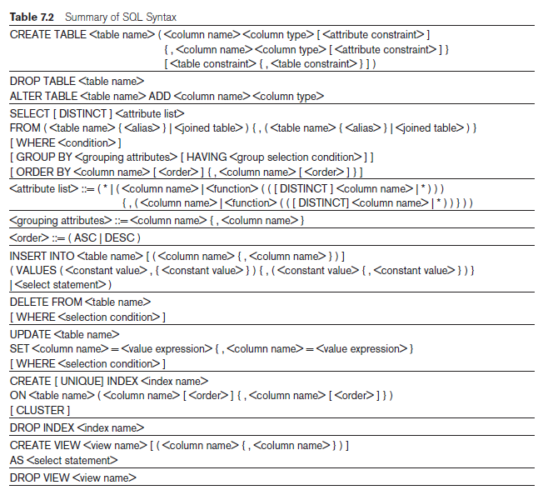
Summary of SQL

Slide 18
Views (Virtual Tables) in SQL
Concept of a View in SQL
A view is a single table that is derived from other tables (that could be base tables or previously defined views).
A view are a virtual table as it is not stored physically in a database.
Can’t use DDL queries on views, however, DML queries can be used
you can query from a view but can’t do all update operations on that.
Used when we have to create reference for frequently accessed data from multiple tables
You can select data from multiple tables,
or you can select specific data based on certain criteria in views.

Slide 19
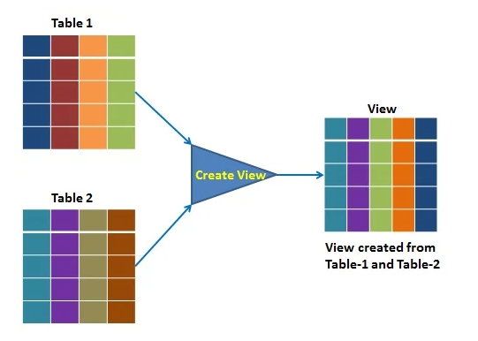
Views (Virtual Tables) in SQL
Concept of a View in SQL
The view is a query stored in the data dictionary, on which the user can query just like they do on tables.
It does not use the physical memory, only the query is stored in the data dictionary.
It is computed dynamically, whenever the user performs any query on it.
Changes made at any point in view are reflected in the actual base table.

Slide 20
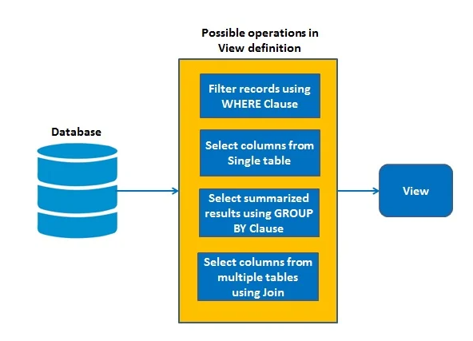
Views (Virtual Tables) in SQL
Concept of a View in SQL
The view has primarily two purposes:
Simplify the complex SQL queries.
Provide restriction to users from accessing sensitive data.

Slide 21
Views (Virtual Tables) in SQL
Concept of a View in SQL
For example, referring to the COMPANY database, we may frequently issue queries that retrieve the employee name and the project names that the employee works on.
STEPS TO BE FOLLOWED:
specify the join of the three tables EMPLOYEE, WORKS_ON, and PROJECT
define a view that is specified as the result of these joins.
issue queries on the view, which are specified as single table retrievals rather than as retrievals involving two joins on three tables.
DEFINING TABLES OF VIEW: tables used in view e.g, EMPLOYEE,PROJECT,WORKS_ON .

Slide 22
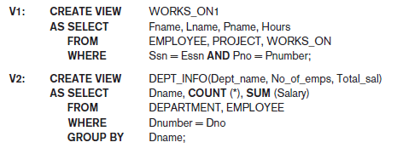
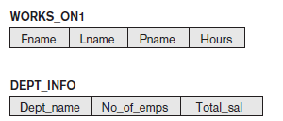
Views (Virtual Tables) in SQL
Specification of Views in SQL
In SQL, the command to specify a view is CREATE VIEW.
Create view contains:
table name (or view name),
a list of attribute names,
and a query to specify the contents of the view.
We could give names for attributes in view. If not, then by default the names mentioned in base tables are used
See the difference in V1 and V2 query.

Slide 23

Views (Virtual Tables) in SQL
Specification of Views in SQL – getting data from views
For example, to retrieve the last name and first name of all employees who work on the ‘ProductX’ project, we can utilize the WORKS_ON1 view and specify the query as in QV1:
If this query is specified on base table, then join between 3 tables is needed for fulfilling the query.
Simplifies complex queries
Ensure security

Slide 24

Views (Virtual Tables) in SQL
Specification of Views in SQL
A view is supposed to be always up-to-date; if we modify the tuples in the base tables on which the view is defined, the view must automatically reflect these changes.
Hence, the view does not have to be realized or materialized at the time of view definition but rather at the time when we specify a query on the view.
If we do not need a view anymore, we can use the DROP VIEW command to dispose of it.
For example, to get rid of the view V1, we can use the SQL statement in V1A:

Slide 25
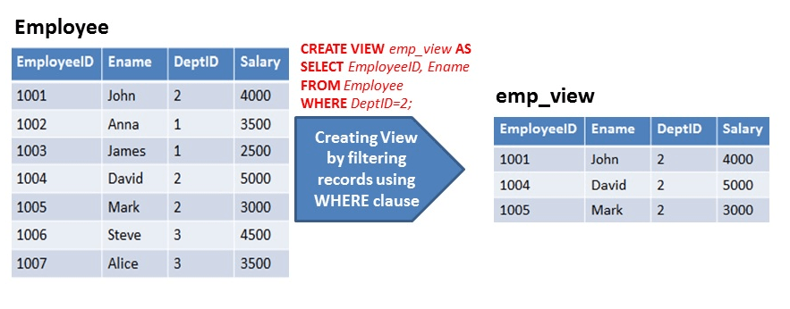
Views (Virtual Tables) in SQL
Types of Views
Simple View: A view based on only a single table, which doesn't contain GROUP BY clause and any functions.

Slide 26
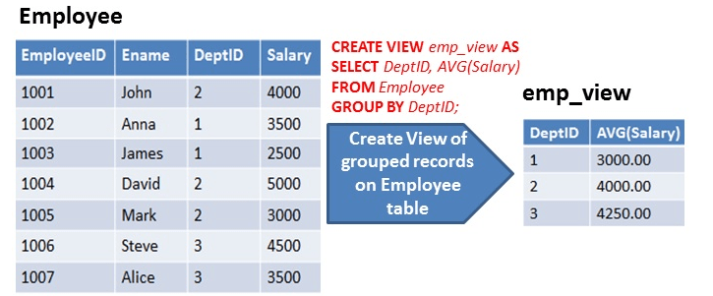
Views (Virtual Tables) in SQL
Types of Views
Complex View: A view based on data drawn from multiple tables, which may also contain GROUP BY clause and functions.

Slide 27
Views (Virtual Tables) in SQL
Types of Views
Materialized View
Materialized view replicates the retrieved data physically.
This replicated data can be reused without executing the view again.
also known as "SNAPSHOTS".
For data warehousing
Advantage: reduce the processing time to regenerate the whole data.
Challenge: synchronize the changes done by views in underlying table. Data consistency between view copy and physical table copy.

Slide 28
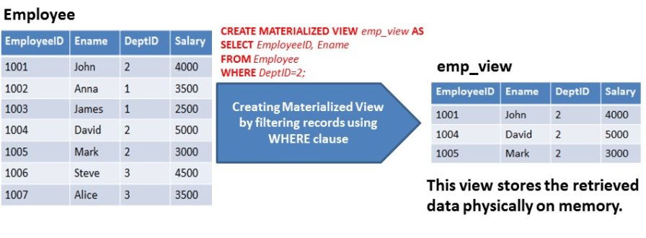
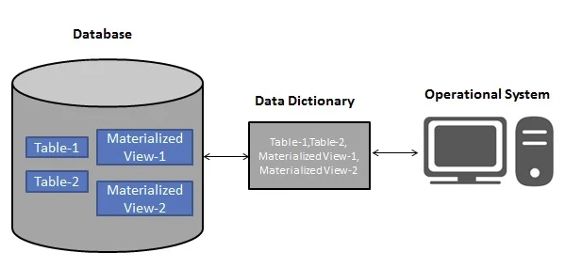
Views (Virtual Tables) in SQL
Types of Views - Materialized View

Slide 29
Views (Virtual Tables) in SQL
View Implementation, View Update, and Inline Views
Problem: How a DBMS can implement a view for efficient querying?
Two solutions:
Query modification
View materialization
query modification - modify the view query (submitted by the user) into a query on the underlying base tables.
Disadvantage:
inefficient for views defined via complex queries that are time-consuming to execute, especially if multiple view queries are going to be applied to the same view within a short period of time.

Slide 30


Views (Virtual Tables) in SQL
View Implementation, View Update, and Inline Views
For example, the query QV1 would be automatically modified to the following query by the DBMS:

Slide 31
Views (Virtual Tables) in SQL
View Implementation, View Update, and Inline Views
view materialization:
physically creates a permanent view table when the view is first created
and keeps that table on the assumption that other queries on the view will follow.
Since a copy of base table is created, so for data consistency, automatically updating the base tables is much needed because the view should contain the up to date data
Techniques using the concept of incremental update have been developed for this purpose,
where the DBMS can determine what new tuples must be inserted, deleted, or modified in a materialized view table when a database update is applied to one of the defining base tables.

Slide 32
Views (Virtual Tables) in SQL
View Implementation, View Update, and Inline Views
The view is generally kept as a materialized (physically stored) table as long as it is being queried.
If the view is not queried for a certain period of time, the system may then automatically remove the physical table and re compute it from scratch when future queries reference the view.
Strategies to update the materialized view:
1. Immediate update strategy: updates a view as soon as the base tables are changed.
2. Lazy update strategy: updates the view when needed by a view query.
3. Periodic update strategy: updates the view periodically (it is possible that a view query may get a result that is not up-to-date).

Slide 33
Views (Virtual Tables) in SQL
View Implementation, View Update, and Inline Views
No restriction for retrieval query against any view.
But update queries are in many cases not possible.
An update on a simple view ≈ multiple updates on the underlying base table under certain conditions.
An update on a complex view ≈ multiple updates on the multiple underlying base tables under certain conditions.

Slide 34

Views (Virtual Tables) in SQL
View Implementation, View Update, and Inline Views
To illustrate potential problems with updating a view defined on multiple tables, consider the WORKS_ON1 view, and suppose that we issue the command to update the PNAME attribute of ‘John Smith’ from ‘ProductX’ to ‘ProductY’.
This view update is shown in UV1:
This query can be mapped into several updates on the base relations to give the desired update effect on the view.

Slide 35
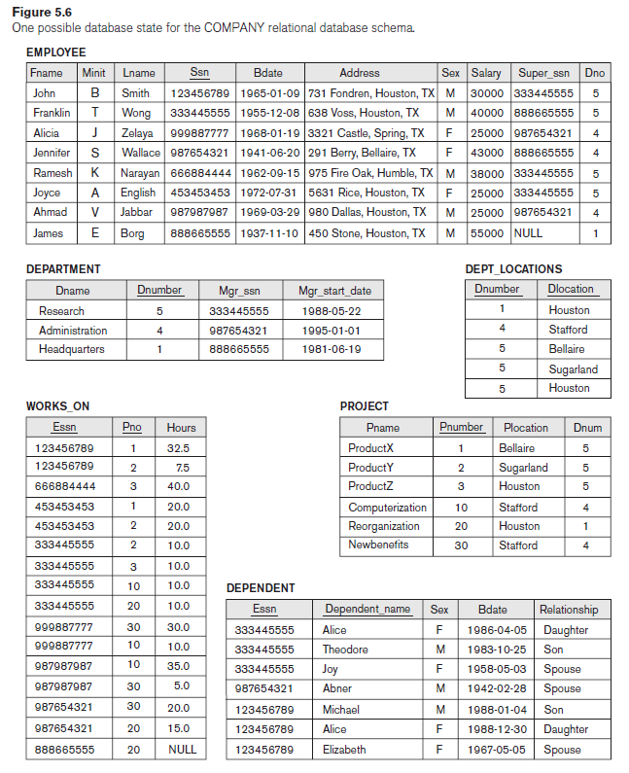
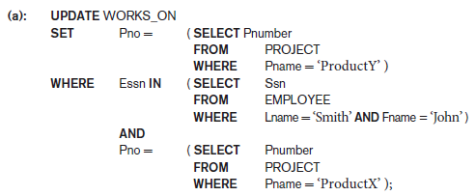
Views (Virtual Tables) in SQL
View Implementation, View Update, and Inline Views
METHOD A:
Update (a) relates ‘John Smith’ to the ‘ProductY’ and is the most likely desired update.
Firstly get the ESSN number of employee and the Pno of product, then update the value t the value of productY

Slide 36

Views (Virtual Tables) in SQL
View Implementation, View Update, and Inline Views
METHOD B:
However, (b) would also give the desired update effect on the view, but it accomplishes this by changing the name of the ‘ProductX’ tuple in the PROJECT relation to ‘ProductY’.
It is an incorrect approach to user query because it also has the side effect of changing all the view tuples with Pname = ‘ProductX’.

Slide 37

Views (Virtual Tables) in SQL
View Implementation, View Update, and Inline Views
Some view updates may not make much sense;
for example, modifying the Total_sal attribute of the DEPT_INFO view does not make sense because Total_sal is defined to be the sum of the individual employee salaries.
This incorrect request is shown as UV2:
Update operations are restricted whenever an update on the view can be mapped to more than one update on the underlying base relations.

Slide 38
Views (Virtual Tables) in SQL
View Implementation, View Update, and Inline Views
When can views be updated or not?
Updatable:
A view with a single defining table if the view attributes contain the primary key of the base relation, as well as all attributes with the NOT NULL constraint with no default values specified.
Not updatable:
Views defined on multiple tables using joins.
Views defined using grouping and aggregate functions.
The view having any DISTINCT clause in its definition.

Slide 39
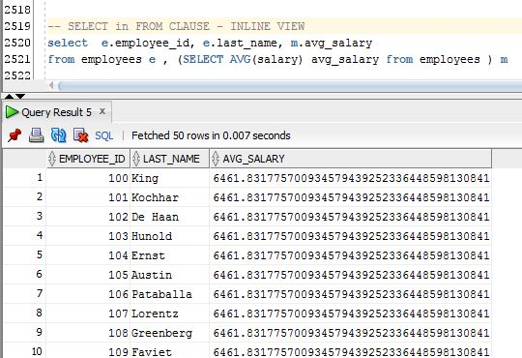

Views (Virtual Tables) in SQL
View Implementation, View Update, and Inline Views
Inline Views:
A view table in the FROM clause of an SQL query is known as an in-line view. Hence, the view is defined within the query itself.
utilized for writing complex SQL queries without join and subqueries operations

Slide 40

Views (Virtual Tables) in SQL
Views as Authorization Mechanisms
Views could be defined for authorization.
Suppose a certain user is only allowed to see employee information for employees who work for department 5.
This user will only be able to retrieve employee information for employee tuples whose Dno = 5 and will not be able to see other employee tuples when the view is queried.

Slide 41

Views (Virtual Tables) in SQL
Views as Authorization Mechanisms
In a similar manner, a view can restrict a user to only see certain columns; for example, only the first name, last name, and address of an employee may be visible as follows:
Thus by creating an appropriate view and granting certain users access to the view and not the base tables, they would be restricted to retrieving only the data specified in the view.

Slide 42
Views (Virtual Tables) in SQL
Advantages of Views
provide an abstraction to various users
hide the complexity for users who are accessing data from multiple tables.
simplify complex queries into a simpler one.
Views can be used for security purposes
does not require disk space
because only the definition is in the data dictionary, not the copy of actual data.

Slide 43
Views (Virtual Tables) in SQL
Disadvantages of Views
More computation time.
Views have a dependency on the table structure.

